Slide 1
ONLINE VOTING SYSTEM
By
Jonny Kumar 21001011027
Manjeet Bamel 21001011035​
Mentored by :
Dr. Rewa Sharma

Slide 2
abstract
We are developing an on-line voting system.
The main concept of this project is to build a website, which should be ablet to allow people to cast their vote by online.
Time saving, working load reduced, information available at the time and it provides security for the data.

Slide 3
Index
Introduction
Problem Statement
Approach to solution
System Architecture
Technology Used
Live Demo
Applications
Conclusions

Slide 4
1. introduction
On-line Voting System is a web based system that facilitates the running of elections and surveys online.
Online voting system provides the online registration form for the users before voting and makes the users to cast their vote online.
This system is to be developed with high security and user friendly.

Slide 5
2. Problem Statement
As information technology evolves over time, the need for a better, faster, more convenient and secure online voting is essential requirement.
The security is the main concerns, such as authentication, confidentiality, integrity and non-repetition. It is not an easy task to achieve secure e-voting.

Slide 6
3. Approach to solution
If a secure and convenient electronic voting system is provided, it will be used more frequently to collect people’s opinion for much kind of political and social decisions through cyber space.
This system has been developed to simplify the process of organizing elections and make it convenient for voters to vote remotely from their home computers while taking into consideration security, anonymity and providing auditioning capabilities.

Slide 7
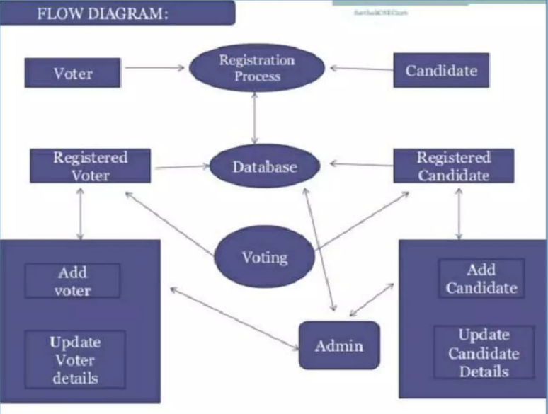
4. System Architecture :

Slide 8
5. Technology used
Programming: Python
Connection: Socket Programming
Protocol: TCP
User Interface: Python-tkinter
Data Storage: Using CSV files
Data Updates: Python- Pandas
OS Calls : Python-subprocess

Slide 9
6. Live demo

Slide 10
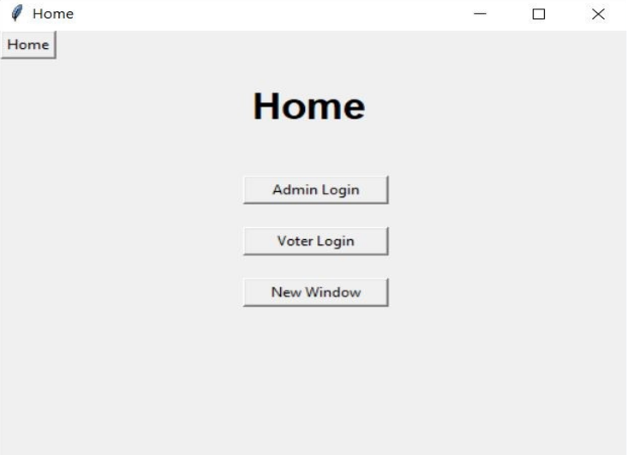

Slide 11
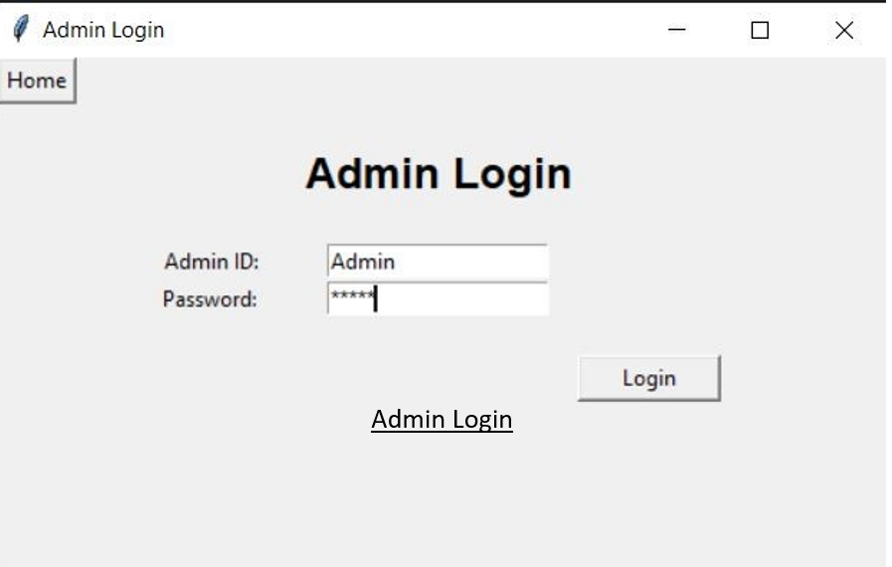

Slide 12
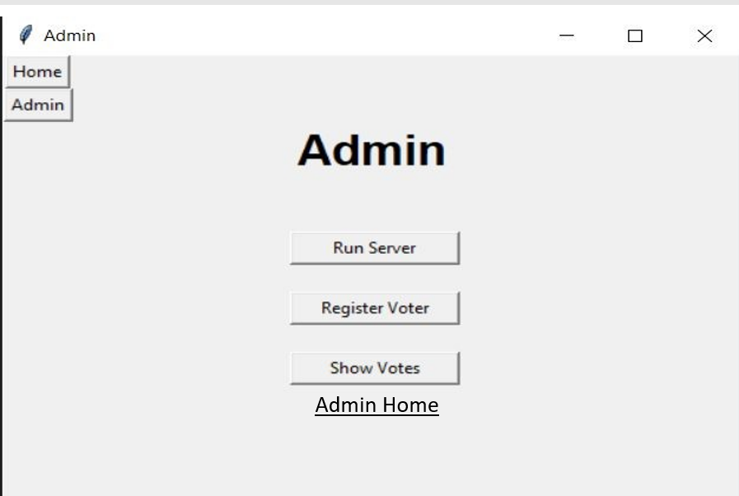

Slide 13
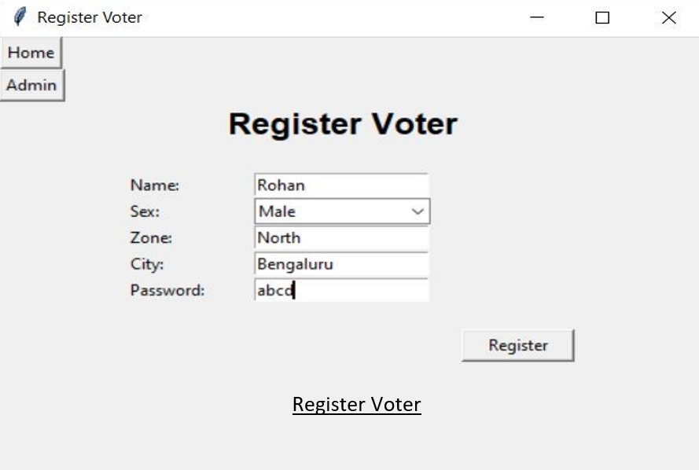

Slide 14
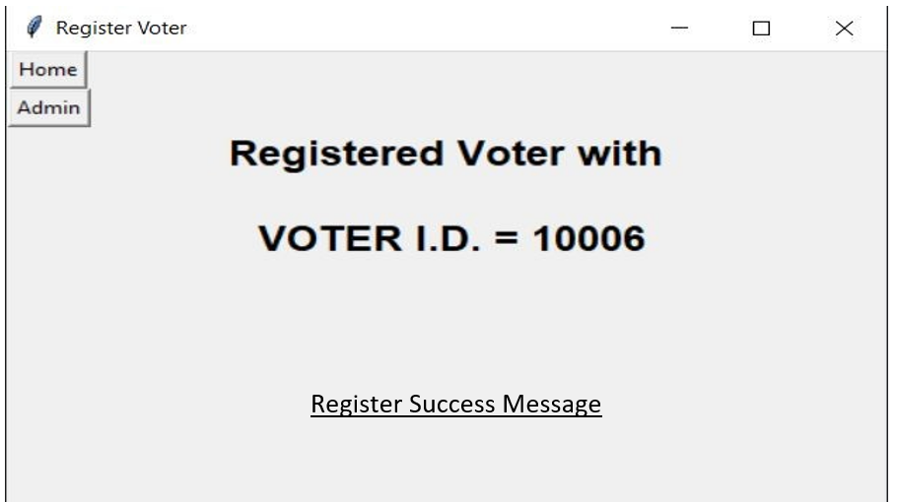

Slide 15
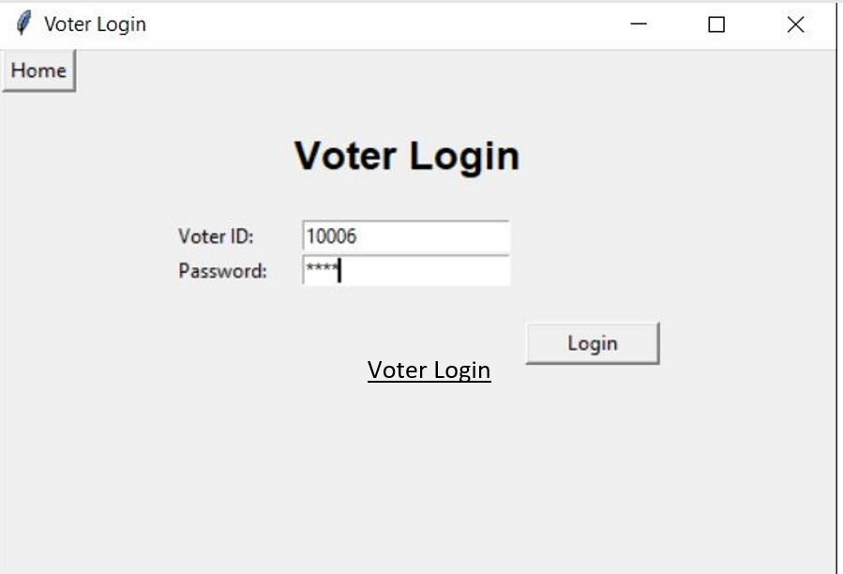

Slide 16
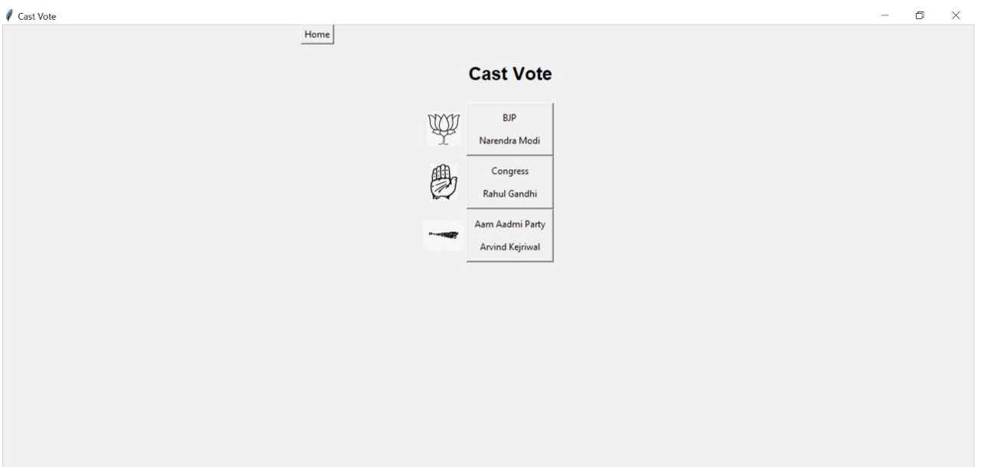

Slide 17
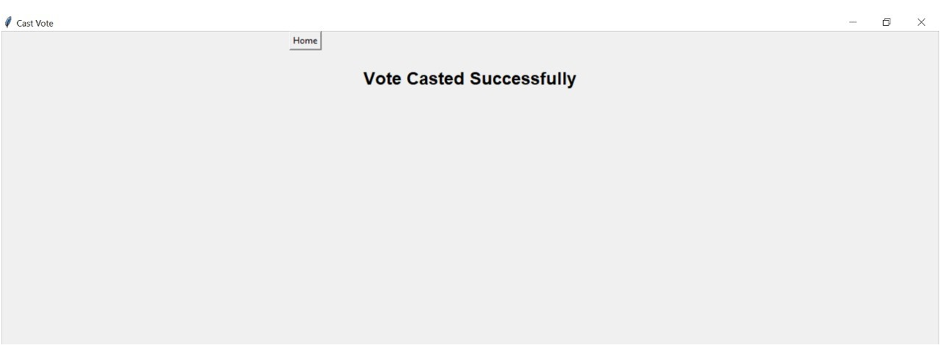

Slide 18
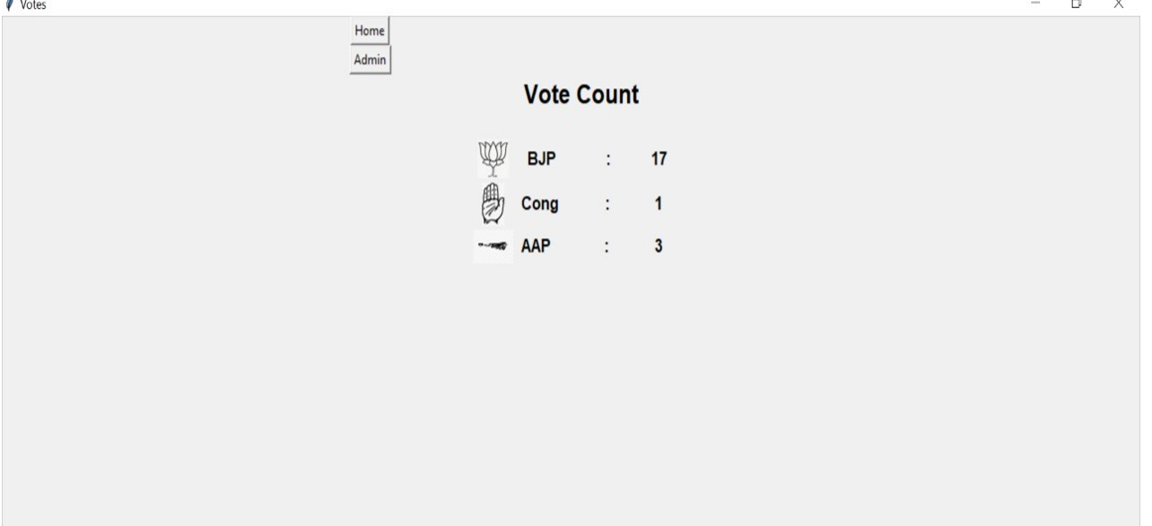

Slide 19
7. Applications
The web-application for today’s mobile and digitally advanced society to participate in the democratic process over the internet.
The online voting system offers the highest levels of transparency, control, security and efficiency of election processes.

Slide 20
8. conclusion
This e-Voting system is able to validate the voter’s identity well and prevent repeating and election.By using this system the voting process will be much faster and safer.

Slide 21
THANK YOU

